Slide 1


Web Scraping of Hyundai Cars Data from Cars24
Presented by
Page 1
Team B
Next Slide

Slide 2

Members of team B
Vinayak Ramavath
Bhukya Raju
Nikhil Bhoi
Bhargav Sai
Diya Singh
Muhammed Sahal
Racha Navya Sree
Hemanth
Akash Kumar
R Sireesha
Tanvi Desai
shubham

Slide 3


What is web scraping ?
A technique used to extract data from the websites
Without manual effort
Analyzing trends in the used market
Page 2
Next Slide

Slide 4


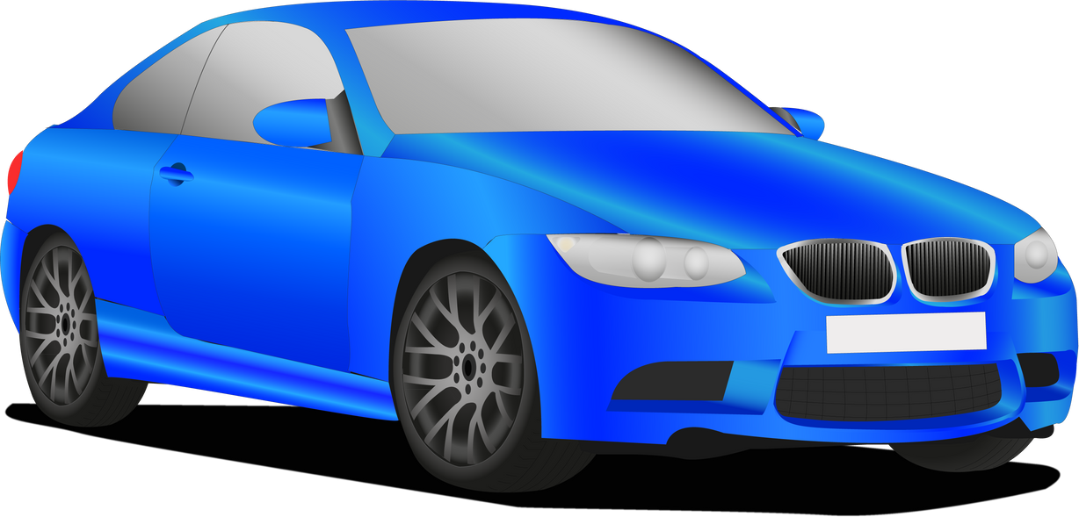
About
Cars24
A platform for buying and selling the used cars
Provides details of different brands and models
Page 3
Next Slide

Slide 5

Technical Implementation
Tools and Libraries Used
Python: Primary programming language 
BeautifulSoup4: HTML parsing and element extraction
Requests: HTTP request handling 
Pandas: Data manipulation and CSV export 
Selenium: JavaScript-heavy content handling
Time: Request rate limiting

Slide 6

DATA EXTRACTION
Scraping Script Development: Python script using BeautifulSoup, Requests, Selenium, Pandas.
Data Fields Targeted:
Kilometers Driven
Year of Manufacture
Fuel Type (Petrol/Diesel/CNG)
Transmission (Manual/Automatic)
Price (₹)
Location

Slide 7
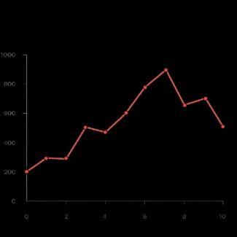

VISUALIZATION
Page 4
Next Slide

Slide 8
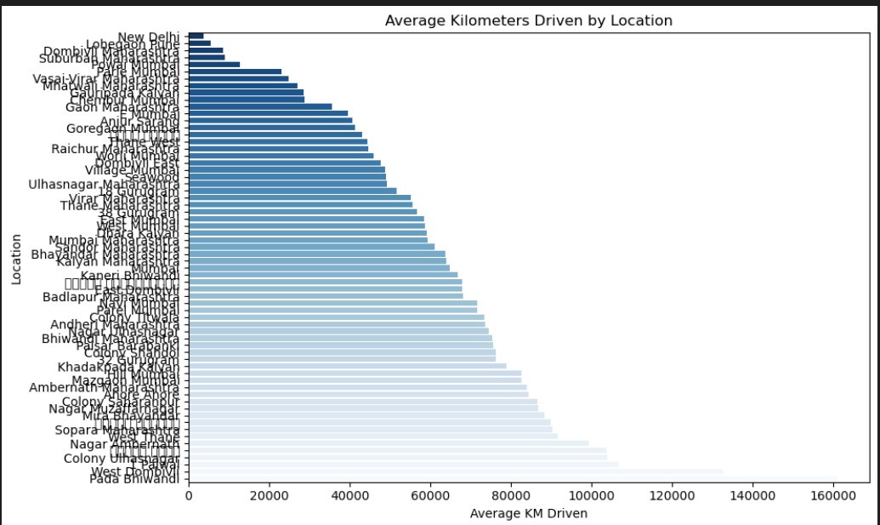
Average kilometer driven by location
Highest Avg. Distance: Pada Bhilwadi – 150,000+ km
Lowest Avg. Distance: New Delhi – <10,000 km
Page 5
Next Slide

Slide 9
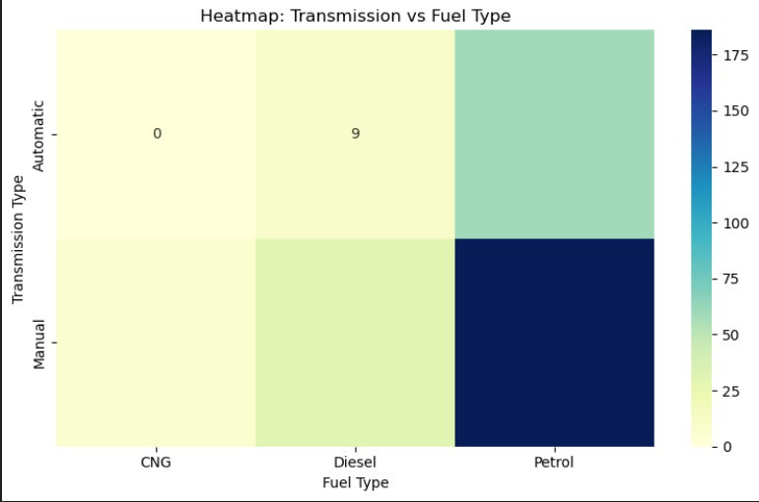
Transmission & Fuel Type Analysis
Dominant Type: Manual Petrol vehicles
CNG Cars: Only manual, no automatics
Page 6
Next Slide

Slide 10
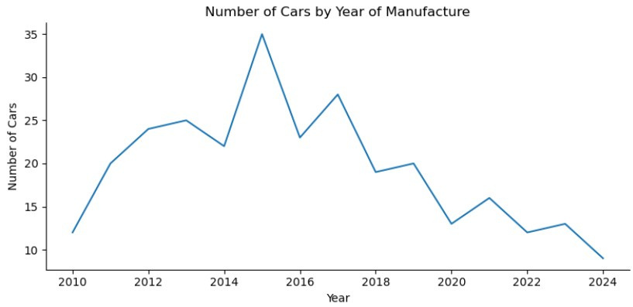
Number of cars by year of manufacture
Usage Range: 150,000+ km (Pada Bhilwadi) to <10,000 km (New Delhi)
Extremes: Highest – Pada Bhilwadi, Lowest – New Delhi
Page 7
Next Slide

Slide 11
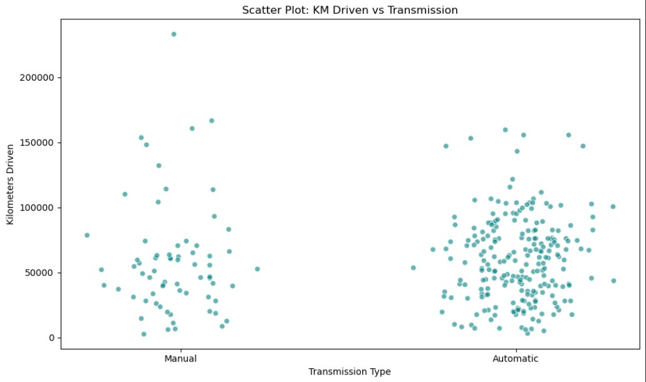
Scatter plot:KM driven vs transmission
Distance Gap: 150,000+ km (Pada Bhilwadi) vs <10,000 km (New Delhi)
Travel Extremes: Highest – Pada Bhilwadi | Lowest – New Delhi
Page 8
Next Slide

Slide 12
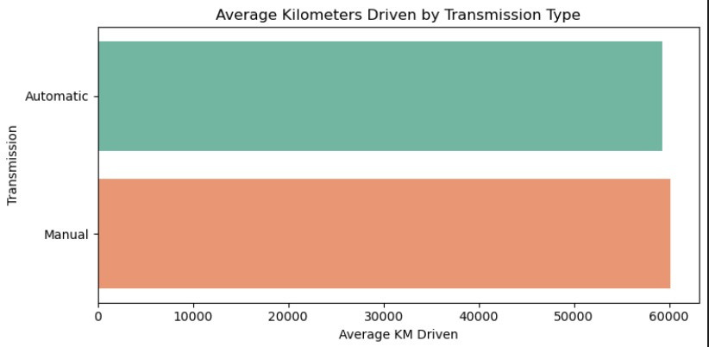
Average kilometers driven by tranmission type
High-Mileage: Pada Bhilwadi & Colony Ulhasnagar – 140,000+ km
Low-Mileage: New Delhi & Dombivli Manpada Shil – very low usage
Page 9
Next Slide

Slide 13
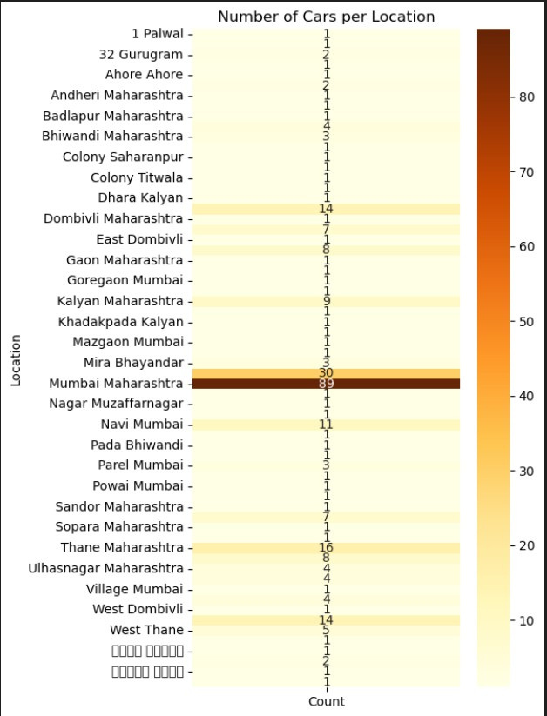
Number of cars per location
Peak: Highest car manufacturing in 2015
Decline: Downward trend since 2017, lowest in 2024
Page 10
Next Slide

Slide 14
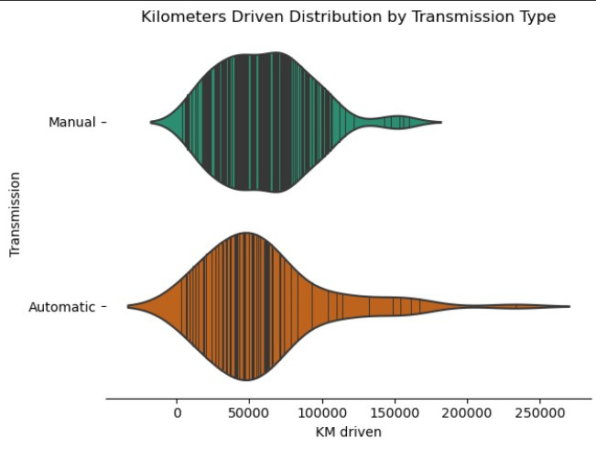
Kilometers driven distribution by transmission type
Automatic Cars: Wider mileage spread with high outliers
Manual Cars: Mostly clustered, few extreme high-mileage cases
Page 11
Next Slide

Slide 15
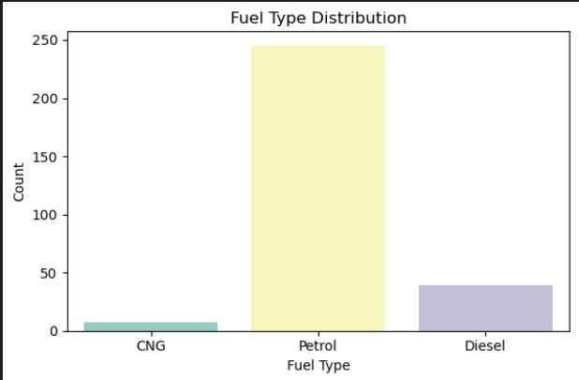
Fuel Type Distribution
Petrol: Dominant fuel type (~250 cars)
CNG & Diesel: Very few, small share of fleet
Page 12
Next Slide

Slide 16
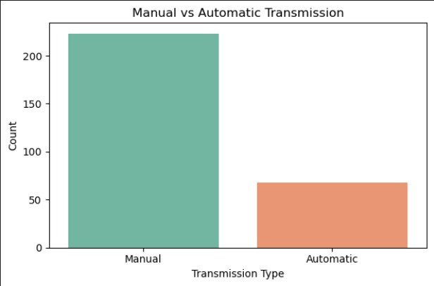
Manual vs. Automatic Transmission
Manual Cars: 200+ vs ~65 automatics
Preference: Manual transmission dominates
Page 13
Next Slide

Slide 17

Market Analysis – Hyundai Cars (Mumbai)
Price Range: Hyundai resale prices in Mumbai vary between ₹3.8L – ₹11.5L, with hatchbacks (i10, i20, Santro) at the lower end and SUVs (Creta, Venue) at the higher end.
Popular Models: The most listed Hyundai models are i10, i20, Creta, Venue, and Santro, with Creta dominating the SUV segment.
Mileage Patterns: Cars with <50,000 km fetch premium resale value, while those with >70,000 km depreciate significantly.
Transmission Trends: Manual cars dominate the listings, but automatic variants (Creta, Venue, Verna) command higher average prices.

Slide 18

Thank
You!
Page 15

